Slide 1
Title I Annual Meeting
A Collaborative Presentation
Department of Federal and State Programs and Title I Schools
Notes:
Presenter dialogue –
Welcome to [inset your school’s name] Title I Annual Meeting. Thank you for attending!

Slide 2
Purpose of Meeting
The Every Student Succeeds Act (a federal law) requires Title I schools to hold an Annual Meeting to explain and discuss the school’s Title I programs, parents’ rights, and other school requirements.
Families are encouraged to ask questions and make suggestions to help improve the school’s Title I program.
Notes:
Presenter dialogue –
According to federal guidelines, every Title I school must hold an informational Annual Meeting. The meeting allows parents and family members to better understand the importance of their role in their child’s education.
It also gives us an opportunity to ask for your input to help us improve our Title I program.
So what is Title I?

Slide 3
What is Title I?
Title I is part of a federal law that grants money to select schools to:
help meet students’ educational needs and goals,
provide staff with professional development, and
support school and family partnerships.
Notes:
Presenter dialogue –
Title I is part of the Every Student Succeeds Act (ESSA), first passed into law as the Elementary and Secondary Education Act in 1965 under President Johnson. The intent of this law was, and still is, to provide federal funds to support schools with high poverty rates to ensure that all children have the opportunity and resources to obtain a high-quality education. To this, Title I funds are used to support instruction, professional development of teachers, and family engagement programs.

Slide 4
How does a school become Title I?
Eligibility for 2023-2024 School Year
District analyzes income data (Free and Reduced Priced Lunch (FRPL), Direct Certification)
District sets eligibility thresholds based on federal and State laws:
70% for elementary, middle and combination schools
67% for high schools
Notes:
Presenter dialogue –
School’s qualify for Title I funding based on the percentage of students eligible to receive free/reduced priced meals. That is why completing the lunch application is very important. The more students who are eligible, the more funding the school receives.

Slide 5
What does it mean for our School?
Additional funds to support students, teachers, and families!
These funds are over and above what the District provides.
Funds concentrated in instruction for students, professional development for our teachers, and activities to strengthen our partnership with families.
Notes:
Presenter dialogue –
The Title I funds are in addition to what the District provides. The funds are used to supplement and create innovative programs at our school, including support for families. In fact, a set amount must be spent on Parent and Family Engagement. Parents and family members are important stakeholders and have the right to give input into how the school will spend the funds.

Slide 6
What does it mean for our School?
Rights for Parents and Families to be informed and involved
Title I Annual Meeting
Decision-making Committees (Stakeholder Input Meeting)
Parents’ Right to be Involved
Parent and Family Engagement Plan*
School-Parent Compact*
Parents’ Right to Know Notifications*
Surveys
Notes:
Presenter dialogue –
* Share these will be discussed further in the presentation.
Parents also have the right to be part of other decision-making committees like SAC and PTA (PTSO) and to request regular meetings. We will be sharing more about parents’ rights and family engagement throughout the presentation.

Slide 7
Schoolwide Title I Programs
All students benefit
All teachers benefit
All families benefit
Title I
Notes:
Presenter dialogue –
It is important to know that the School District of Palm Beach County implements the Schoolwide Title I model. This means all students, teachers, parents and family members in a Title I school benefit from the funding and services regardless of which students made the school eligible. In a schoolwide program, all students, teachers and families benefit.

Slide 8
Our Schoolwide Plan (SWP)
Everglades Preparatory Academy build students' social-emotional skills via:
School-wide implementation of Positive Behavior Interventions and Support (PBIS) otherwise known as School-wide Positive Behavior Support. Students are taught the pillars of Panther P.R.I.D.E. which include (P) Purpose, (R) Respect, (I) Integrity, (D) Discipline and Determination and (E) Excellence. Each week, teachers select a Student of the Week. These students receive an incentive such as extra credit, a homework pass, etc. Students that exhibit elements of Panther P.R.I.D.E. are also given tickets that can be redeemed for snacks, etc. Students are also eligible to participate in campus activities based on their adherence to the pillars of Panther PRIDE.
Each teacher has signed up to be a "Graduation Coach" for at least 2-3 seniors. They will coach the seniors towards graduation.
Students participate in programs such as Student ACEs, Palm Beach County Youth Services, etc.
Notes:
INFORMATION TO PREPARE IN ADVANCE - Customize this slide (or multiple slides – next 2 slides) Summarize your school’s SWP.
Be sure to include the data used to determine your plan (share your current Winter diagnostics assessment results and your FY21 expected outcomes).
Presenter Dialogue - Provide some details on the action steps and programs you will undertake in this school year.
Briefly touch on narrative components (main ideas).
Encourage parents to ask questions. Ask for their input. Ask specific questions to prompt discussion.
Be sure to note comments, questions, and suggestions for your Annual Meeting Minutes!

Slide 9
Our Schoolwide Plan (SWP)
Everglades Preparatory Academy implements SBT/MTSS. Teachers regularly discuss the 3 tiers (Tier 1- Core, Tier 2- Supplemental, Tier 3- Intensive) Team Huddles/School-Based Team Meetings to determine how we can support the students at the Core and then develop tiered interventions to support those students who need additional supplements and /or intensive supports.
Teachers refer students to the SBT Leader for discussion/problem-solving during SBT meetings. Student progress is tracked using progress monitoring tools for both academics, behavior and attendance.
Supplemental supports include academic tutoring and mentoring for behavior/attendance. Each student that is below a 2.0 or is in intensive reading is referred to SBT. Students that exhibit on-going discipline issues are referred to SBT.
Mandatory referrals include homelessness, pregnancy, and foster care. The SBT utilizes interventions available internally and collaborates with community organizations as necessary
Notes:
INFORMATION TO PREPARE IN ADVANCE - Customize this slide (or multiple slides – next 2 slides) Summarize your school’s SWP.
Be sure to include the data used to determine your plan (share your current Winter diagnostics assessment results and your FY21 expected outcomes).
Presenter Dialogue - Provide some details on the action steps and programs you will undertake in this school year.
Briefly touch on narrative components (main ideas).
Encourage parents to ask questions. Ask for their input. Ask specific questions to prompt discussion.
Be sure to note comments, questions, and suggestions for your Annual Meeting Minutes!

Slide 10
Our Schoolwide Plan (SWP)
Everglades Preparatory Academy strives to provide a well-rounded education. Teachers and administrators use data to drive instruction. This data includes but is not limited to FAST Progress Monitoring Data, FSA data, SAT/ACT, ReadingPlus, Delta Math, Performance Matters FSQs and USAs, and teacher-created alternative assessments.
All lessons are developed in alignment with the BEST Standards and all teachers actively use CPalms as a resource to ensure that their lessons are aligned and relevant. Teachers are also supported by district curriculum specialists and follow the Scope and Sequence designed for their content area.
Everglades Preparatory Academies seeks collaborative partnerships that can provide exposure and information to our students such as Student ACEs, Palm Beach State, CareerSource, and Families First.
Everglades Preparatory ensures that students’ needs are met according to their 504/IEP Plan. Everglades Preparatory Academy utilizes APEX Learning to provide additional course recovery and course content.
Notes:
INFORMATION TO PREPARE IN ADVANCE - Customize this slide (or multiple slides – next 2 slides) Summarize your school’s SWP.
Be sure to include the data used to determine your plan (share your current Winter diagnostics assessment results and your FY21 expected outcomes).
Presenter Dialogue - Provide some details on the action steps and programs you will undertake in this school year.
Briefly touch on narrative components (main ideas).
Encourage parents to ask questions. Ask for their input. Ask specific questions to prompt discussion.
Be sure to note comments, questions, and suggestions for your Annual Meeting Minutes!

Slide 11
Our Schoolwide Plan (SWP)
Staff has built student awareness of and readiness for post-secondary opportunities and the workforce pathway to rigorous coursework, relevance, and engagement of the high school curriculum and college/military awareness programs. This pathway will include students who have traditionally faced barriers to successful post-secondary transitions.
EPA is also in the process of developing a CTE career pathway in the area of Agritechnology. EPA Career Pathway—promotes dual/college enrollment and better job skills through collaborations among colleges, public schools, and businesses. This pathway utilizes career and technical courses, job shadowing, workshops, and counseling to assist students who have average academic performance with their career plans and applications.
EPA collaborates with CareerSource Palm Beach County, Student ACEs, Project Lift and the Environmental Resource Management Department of Palm Beach County to provide job shadowing, training and placement opportunities. EPA hosts an Annual College and Career Day.
Notes:
INFORMATION TO PREPARE IN ADVANCE - Customize this slide (or multiple slides – next 2 slides) Summarize your school’s SWP.
Be sure to include the data used to determine your plan (share your current Winter diagnostics assessment results and your FY21 expected outcomes).
Presenter Dialogue - Provide some details on the action steps and programs you will undertake in this school year.
Briefly touch on narrative components (main ideas).
Encourage parents to ask questions. Ask for their input. Ask specific questions to prompt discussion.
Be sure to note comments, questions, and suggestions for your Annual Meeting Minutes!

Slide 12
Our Schoolwide Plan (SWP)
Everglades Preparatory Academy coordinates and provides professional development opportunities for teachers through Team Huddles, Collaborative Planning, Data Analysis Meetings, coaching/mentoring, modeling, etc. Teachers meet once per week from 2:45pm to 4:00pm to engage in professional development. District curriculum support specialists are utilized to provide content area support.
The SIP Team conduct classroom walkthroughs and observations to support student achievement. Teachers engage in peer observations and PLCs.
Everglades Preparatory Academy collaborates with Glades Academy as applicable.
Everglades Preparatory Academy implements the SDPBC's Educator Support Program; when applicable.
Notes:
INFORMATION TO PREPARE IN ADVANCE - Customize this slide (or multiple slides – next 2 slides) Summarize your school’s SWP.
Be sure to include the data used to determine your plan (share your current Winter diagnostics assessment results and your FY21 expected outcomes).
Presenter Dialogue - Provide some details on the action steps and programs you will undertake in this school year.
Briefly touch on narrative components (main ideas).
Encourage parents to ask questions. Ask for their input. Ask specific questions to prompt discussion.
Be sure to note comments, questions, and suggestions for your Annual Meeting Minutes!

Slide 13
Our Schoolwide Plan (SWP)
Recruiting and retaining excellent teachers is critically important for the success of Everglades Preparatory Academy (EPA).
To improve the recruitment and retention of excellent teachers: 1. EPA has invested in the development of high-quality leaders who work to include teachers in decision-making and foster positive school cultures. 2. EPA has surveyed its teachers to assess the quality of the teaching and learning environment and to guide improvements. 3. EPA has incentivized professional development strategies and the redesign of the school’s culture to provide for greater collaboration.
Systematic and sustained collaboration among teachers requires changes in scheduling and resource allocation so that teachers have the time necessary for productive collaboration, which improves teacher efficacy and retention.
Everglades Preparatory Academy's process for recruiting new teachers when one is needed is by: Hiring Team: Principal, Assistant Principal, Lead Teacher, ESE Coordinator, Other Staff Members as appropriate. Phase 1: Advertise position on Indeed Phase 2: Screen potential candidates based on their application submissions- cover letters, resumes, experience, and certifications Phase 3: Contact the potential candidates to determine level of interest in the position. Phase 4: If interested, schedule a 5–10-minute video call with the potential candidate. It is important to me to ensure that my personality “vibes” with the potential candidate and whether or not the candidate would be able to “fit in to” the overall culture of the school. Phase 5: If interested in continuing the conversation, schedule a time for the candidate to meet with the principal Phase 6: Vet the potential candidate by contacting their references. Phase 7: If there is continued interest, ask the candidate to submit a sample lesson plan and if able, teach a sample lesson. Interview Questions typically asked: 1. What interested you in applying to Everglades Preparatory Academy? 2. How do you feel you can provide “value-added” to Everglades Preparatory Academy? 3. How have you/would you, use data to drive your instruction? 4. What is your greatest strength? 5. What is your greatest opportunity for growth? 6. How do you like to receive feedback about your instructional/professional practice
Notes:
INFORMATION TO PREPARE IN ADVANCE - Customize this slide (or multiple slides – next 2 slides) Summarize your school’s SWP.
Be sure to include the data used to determine your plan (share your current Winter diagnostics assessment results and your FY21 expected outcomes).
Presenter Dialogue - Provide some details on the action steps and programs you will undertake in this school year.
Briefly touch on narrative components (main ideas).
Encourage parents to ask questions. Ask for their input. Ask specific questions to prompt discussion.
Be sure to note comments, questions, and suggestions for your Annual Meeting Minutes!

Slide 14
Title I Focus
To meet our expected outcomes, we are using this year’s Title I funds for the following:
Non-Certified Academic Tutor to Support APEX Instruction
Supplies for Professional Development for Teachers and Instruction for Students
Online Subscription to Support Instruction- Newsela
Notes:
Customize this slide to detail what your school is doing with Title I funds this year to increase student achievement for all students.
Share details for each bulleted item.

Slide 15
Parent & Family Engagement
Research shows that when parents and family members are involved, students are more likely to:
earn better grades
do better on tests
attend school
adapt to change
have better social skills
be promoted to the next grade
graduate
continue their education after high school
Notes:
Presenter dialogue –
Our Schoolwide Plan involves the entire school community, including families. Researchers have studied the benefits of family involvement in schools and have found that students are positively impacted when their families are involved in their education. Students…(read bullets).

Slide 16
Parent & Family Engagement Plan
Shortened to PFEP
Describes how we involve families in students’ education
Written with the input of our school’s families and staff during the Stakeholder Input Meeting
Shared during SAC to review and revise as needed
PFEP Summaries sent home for all families
Notes:
Presenter dialogue –
We recognize the importance of partnering with families so students reap those benefits. Part of our Schoolwide Plan includes how we partner with families to help students succeed. In fact, we have an entire plan that outlines the steps we will take to strengthen our partnership with families.

Slide 17
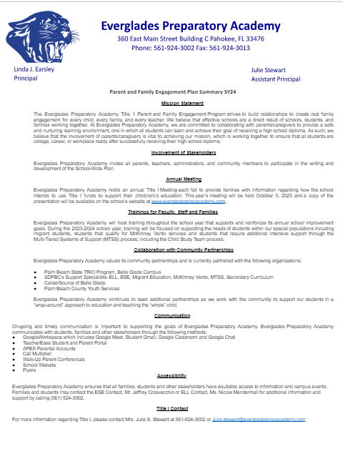
Parent & Family Engagement Plan
Notes:
Presenter dialogue –
The plan describes how the school partners with the community, volunteers, and businesses to increase student achievement. It also outlines specific academic trainings designed for parents and family members to learn strategies they can use at home and help their children master specific foundational skills.
Share – PFEP Summary will be posted on the school website. Optional – navigate to the school’s website.

Slide 18
Parent Trainings
In alignment with the Parent and Family Engagement Plan, we would like to invite you to attend our upcoming trainings:
Supporting Your Child in APEX
Understanding FDOE Graduation Requirements
Understanding the FDOE Graduation Requirements for SY24- Senior Night
Notes:
Customize this slide to detail what your school is doing with Title I funds this year to increase student achievement for all students.
Be sure to include learning outcomes for parents. What can they expect to learn from attending these trainings?
** It is recommend to conduct trainings virtually.
Optional = Ask parents to enter these dates in their phone/calendar as save the date.

Slide 19
School-Parent Compact
Each Title I school must have a School-Parent Compact that is written by parents, family members and school personnel.
The School-Parent Compact sets out the responsibilities of the students, parents, family members, and school staff in striving to raise student achievement.
Notes:
Presenter dialogue –
An important part of the Parent and Family Engagement Plan is our School-Parent Compact. The Compact is also developed jointly with parents, family members and staff and outlines the responsibilities each have to raising student achievement.

Slide 20
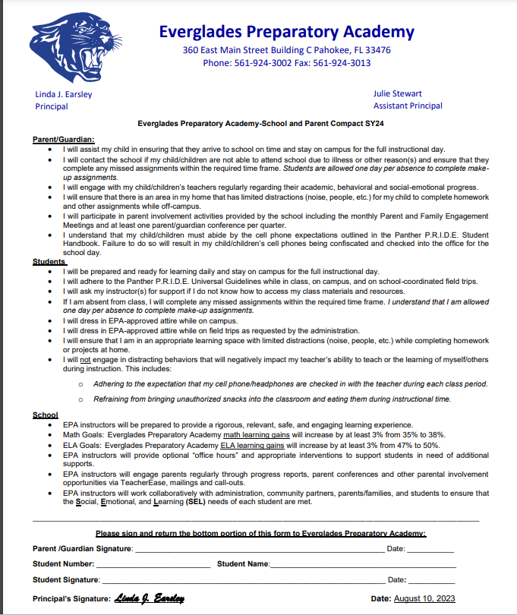
School-Parent Compact
Review of FY24 School-Parent Compact
Suggestions for next year’s Compact
Questions
Notes:
Share your school’s final Compact.
Share with parents:
the importance of the School-Parent Compact
how it was developed and
how it is going to be used to impact student achievement
the Compact will be revisited during ELEMENTARY parent-teacher conferences (as required by law)

Slide 21
Parents’ Right to Know
Families have the right to ask:
about the professional qualifications of their child’s teachers; and
if non-teacher personnel are providing instruction to their child and, if so, their professional qualifications.
Notes:
Presenter dialogue –
Title I schools must inform parents and family members of their rights. Parents and family members have the right to request information regarding their child’s teachers and paraprofessionals’ qualifications and their child’s academic level and growth on State assessments.

Slide 22
Parents’ Right to Know
Families must be informed:
if their child is taught for four or more weeks by a teacher who does not meet the certification requirements for the grade level or subject being taught; and
how their child performed on state tests like FSA, EOCs, and SSA.
Notes:
Presenter dialogue –
Parents must be notified if their child has been taught for four or more weeks by a teacher who is licensed to teach in the State of Florida, but does not hold a certificate to teach the grade or subject listed above.
Parents must also be notified if their child has been taught for four or more weeks by a substitute teacher who is approved by the District to substitute teach, but does not hold a Florida Department of Education teaching certificate for the grade level or subject listed above.
School must share with parents their child’s assessments results (FSA, EOC and SSA).

Slide 23
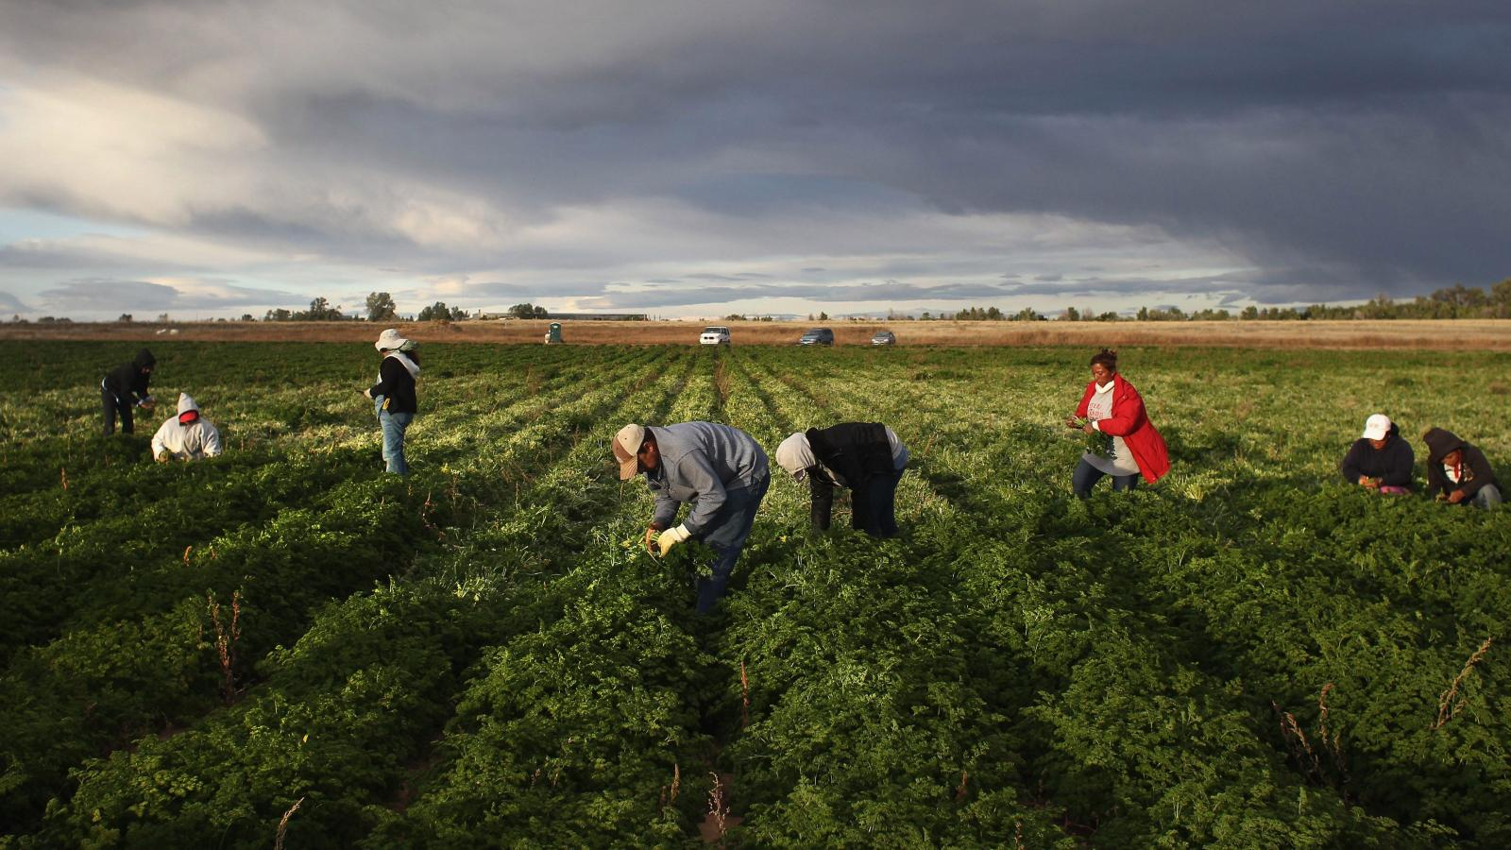
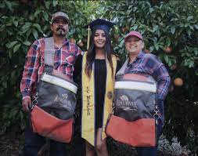
High-performing A-rated District
Migrant Education Program (MEP)
The GOAL of the MEP is to assist all migrant students in meeting challenging academic standards and achieving graduation from high school (or a GED program) with an education that prepares them for responsible citizenship, further learning, and productive employment.
Notes:
Presenter dialogue –
​Migrant families are constantly moving from one state to another, from one district to another, in search of agricultural work. They children fall behind due to their high mobility. These children may be eligible for services provided by the Migrant Education Program. The goal of the MEP is to …
​

Slide 24
Migrant Education Program
Ensure the needs of migrant students are met to help them overcome:
interruption in schooling
cultural and language barriers
social isolation
lack to health resources
transition to college or work after high school
To improve educational opportunities of migrant students by helping them:
Supplemental academic/social services to students and their families
Transition to new school(s)
meet the challenging state/district academic content
graduate from high school
Notes:
Presenter dialogue –
The program provides supplemental academic and social support to migrant students and their families.

Slide 25
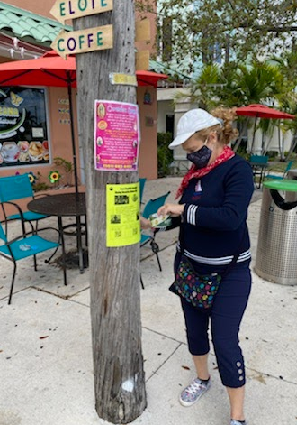
High-performing A-rated District
First step is to find all migrant students
Interviews are done in person by a training MEP Recruiter using Federal & State eligibility requirements
Program Contact Information:
Jorge Echegaray
Manager, Migrant Education Program
Multicultural Education Department
Jorge.Echegaray@palmbeachschools.org
(561) 202-0356
Notes:
Presenter dialogue –
The program provides supplemental academic and social support to migrant students and their families. However, the
The Parent/Guardian must be interviewed to see if they qualify.
Parents may call the school to ask for an interview. ​

Slide 26
Students Experiencing Homelessness Every Student Has the Right to an Education
The McKinney-Vento Homeless Education Program (MVP) Team can help students and families who live:
in a shelter, motel, vehicle, or campground;
on the street;
in abandoned buildings or substandard housing;
in motels/hotels; or
doubled-up temporarily with relatives or friends due to a hardship
Notes:
Presenter dialogue –
In addition to the services that we provide to the migrant students, do you know that our District also provides support and services to students experiencing homelessness, including unaccompanied homeless youth? Unaccompanied homeless youth are homeless youth not in the physical custody of a parent or guardian.

Slide 27
Students Experiencing Homelessness
Every school has a McKinney-Vento Contact Person & assigned McKinney-Vento Program (MVP) Case Manager who works with families to:
provide school supplies, uniforms, supplemental services and free school meals;
set up transportation to and from the school of origin;
find community support and resources;
decide which school would be best for the child (the school of origin, or the zone school);
communicate with the school;
and so much more.
Notes:
Presenter dialogue –
Every effort is made to address the needs of students and families experiencing homelessness. Families can contact the school to find more information on the services the school and District provide.

Slide 28
Students Experiencing Homelessness
MVP Contact Information
Contact the McKinney-Vento Homeless Education Program (MVP) if you have questions or to complete a Student Housing Questionnaire
(561) 350-0778
MVPhomeless@palmbeachschools.org
MVP Website

Slide 29
Conclusion
Parents’ opportunity to ask questions and provide feedback
Complete evaluation
Thank you for your attendance, participation, and feedback.
We look forward to a successful school year!
Notes:
Presenter dialogue –
Ask if there are any questions.
Ask participants to complete evaluation using the link posted to school website under Annual Meeting.
Thank participants for attending.

