Slide 1

Student Orientation FY26
August 7, 2025

Slide 2
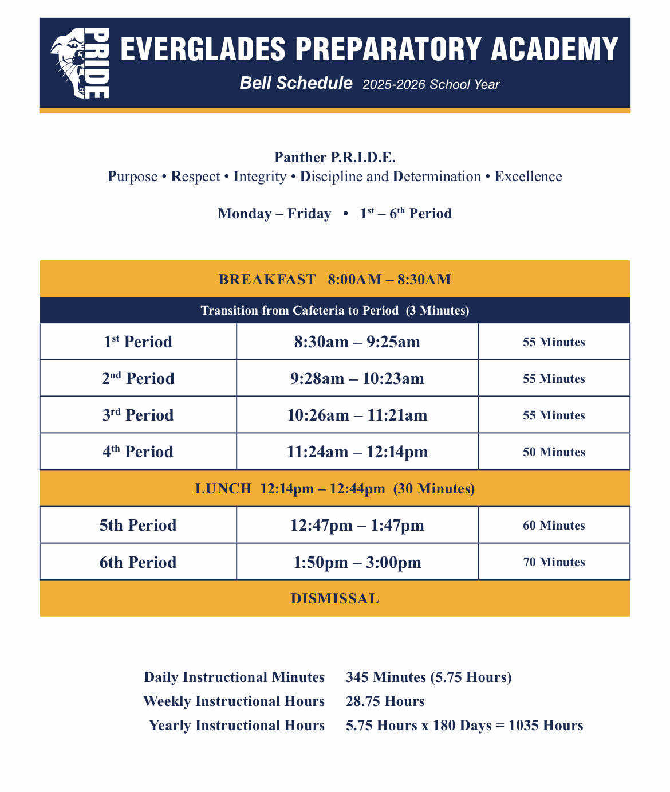
Bell Schedule

Slide 3
Mission
The mission of the Everglades Preparatory Academy is to offer students and parents a non-traditional, smaller, innovative and challenging learning environment to meet the unique and diverse needs of its community.
The goal of Everglades Preparatory Academy is to provide a welcoming, supportive, interactive and technology-rich secondary program that will prepare each student for post-secondary education and a successful career, while providing dropout prevention and academic intervention services through alternative education.

Slide 4
Vision
The faculty and staff at Everglades Preparatory Academy will promote its vision for students by continuously striving to meet the following goals:
To inspire students’ creativity, enthusiasm and desire to learn by offering a challenging, interactive and technology-rich learning environment. To develop in students a strong confidence in their abilities to reach their goals by assisting them in becoming adequately prepared to enter a college program or career preparation program that will give them opportunities for future employment. To instill in students a sense of responsibility, a concern for the welfare of others and a desire to become contributing members of society by providing them with leadership opportunities, positive mentors and role models by establishing partnerships with community businesses and organizations.

Slide 5
DRESS CODE
Students are expected to adhere to Everglades Preparatory Academy Dress Code Guidelines and dress for excellence while learning on campus and during off-campus events.
Student clothing should be “school appropriate” at all times:
Students must wear solid color polo shirt everyday White, Navy blue, or Yellow
Students may not wear midriff or sleeveless shirts that show excessive amounts of skin..
Students may not wear leggings, biker shorts, or bodysuits without appropriate coverage such as a jacket, long shirt, etc.

Slide 6
Dress Code Continued
Students must wear close-toed shoes and shoes with straps. Strapless sandals and slides are not permitted. Under no circumstances are students allowed to attend a school field trip with slides or strapless shoes.
Students must wear an Everglades Preparatory Academy school shirt on all field trips; unless otherwise specified by administration.
Students must have a clear or mesh backpack.
Students are not permitted to wear hats, hoodies, ski masks or sunglasses while on campus or during school-related activities; including classroom instruction.
Administration has full discretion to decide whether a students’ clothing are school/field trip appropriate.

Slide 7
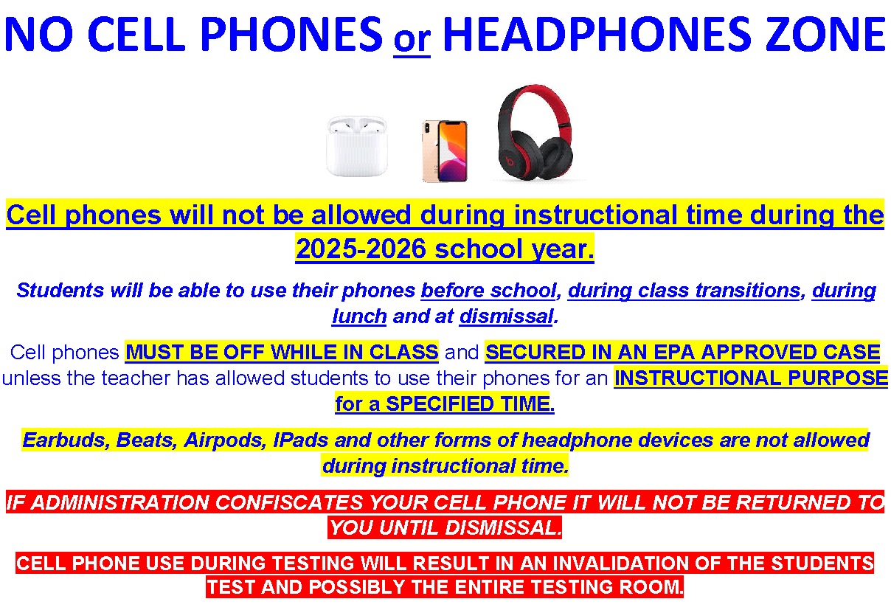

Slide 8
Attendance
Students that are late will be marked tardy.
Students that are absent from school, must have a letter of excuse from a doctor and/or parent/guardian for the absence to be excused.
Absent students have one day per absence to make up missing assignments
Each student is required to attend classes one hundred and eighty (180) days each school year. To be in compliance with these attendance requirements, students must not accumulate fifteen(15) unexcused absences in a period of ninety (90) calendar days.

Slide 9
Attendance
Students that have three (3) consecutive absences within a quarter will receive and email and/or phone call home.
Students that accumulate five (5) consecutive days within a quarter will be required to have a parent/guardian conference.
Students that accumulate 7-10 unexcused absences within a quarter, consecutive or not, will be placed on an attendance contract and be in danger of being withdrawn from Everglades Preparatory Academy.
Attendance is a major contributing factor to the success of students.

Slide 10
Procedures for Leaving Campus
Everglades Preparatory Academy Students may only be released to pre-approved designees that are listed in the Students Information System(SIS). Make sure you bring photo ID. Students/Parents/Guardians must complete the sign out log in the main office prior to leaving campus.
Students are not permitted to come to the main office and ask for permission to leave campus unless they have informed their instructor that they are ill and need to go to the office. At that point, a parent/guardian will be contacted to arrange for transportation.

Slide 11
Procedures for Leaving Campus
Students including seniors are not permitted to leave campus for breakfast or lunch and/or have breakfast/lunch delivered to campus.
Students that sign out early habitually due to illness and/or appointments or work will be required to provide evidence/ documentation such as a doctor’s note.
Students that leave school early habitually will be in danger of withdrawal from Everglades Preparatory as attendance is important to their academic success. Will be at risk for a truancy court referral.

Slide 12
ESE, ELL, and 504 plans
Mr. Colavecchio is the ESE Coordinator here at EPA
My role and responsibilities as ESE Coordinator include…
Scheduling and Leading IEP Review, Re-evaluation, and 504 plan meetings
Leading Support Facilitation and Consultation services
Coordinating SLP services
Progress monitoring of Student goals outlined on IEPs
Uploading Accommodations for Testing (ie… CLT, FAST, etc.)
ELL Contact role and responsibilities…
WIDA assessments and testing
Progress Monitoring

Slide 13
Guidance & Counseling
Mrs. Franco- School Counselor
Academic Counseling and Workshops (Graduation Ready, Postsecondary Planning).
Individual and Group Counseling (Mental Health, SLL).
Provides wraparound services to assist and support students both personally and academically.
Connects parents and students with community resources.
Collaborates with stakeholders (parents, teachers, community based programs, etc.).
Conducts meetings pertaining to student concerns/support.
Mr. Jones- Parent Liaison
Assists School Counselor with setting up one-on-one meetings and parent/student conferences.
Supports School Counselor with Credit Recovery and Monitoring Senior Progress.
Streamlines important communications to students and their families through announcements, google classroom, phone calls home, mailed letters, etc.

Slide 14
Questions?

