Slide 1

Title I Annual Meeting
A Collaborative Presentation
Department of Federal and State Programs and Title I Schools
Notes:
Presenter dialogue –
Welcome to [inset your school’s name] Title I Annual Meeting. Thank you for attending!

Slide 2


Purpose of Meeting
The Every Student Succeeds Act (a federal law) requires Title I schools to hold an Annual Meeting to explain and discuss the school’s Title I programs, parents’ rights, and other school requirements.
Families are encouraged to ask questions and make suggestions to help improve the school’s Title I program.
Notes:
Presenter dialogue –
According to federal guidelines, every Title I school must hold an informational Annual Meeting. The meeting allows parents and family members to better understand the importance of their role in their child’s education.
It also gives us an opportunity to ask for your input to help us improve our Title I program.
So what is Title I?

Slide 3


What is Title I?
Title I is part of a federal law that grants money to select schools to:
help meet students’ educational needs and goals,
provide staff with professional learning, and
support school and family partnerships.
Notes:
Presenter dialogue –
Title I is part of the Every Student Succeeds Act (ESSA), first passed into law as the Elementary and Secondary Education Act in 1965 under President Johnson. The intent of this law was, and still is, to provide federal funds to support schools with high poverty rates to ensure that all children have the opportunity and resources to obtain a high-quality education. To this, Title I funds are used to support instruction, professional development of teachers, and family engagement programs.

Slide 4


How does a school become Title I?
Eligibility for 2025-2026 School Year
  District analyzes income data (Free and Reduced Priced Lunch (FRPL), Direct Certification)
District sets eligibility thresholds based on federal and State laws:
    70% for elementary, middle and combination schools
    67% for high schools
Notes:
Presenter dialogue –
Palm Beach County is now a Community Eligibility Provision (CEP) district meaning all students receive free breakfast and lunch. School’s qualify for Title I funding based on the percentage of students that are direct certified by the State. The more students who are eligible, the more funding the school receives. Students must fall between the ages of 5 and 17 in order to be counted in the calculation.

Slide 5
What does it mean for our School?
Additional funds to support students, teachers, and families!
  These funds are over and above what the District provides.
  Funds concentrated in instruction for students, professional learning for our teachers, and activities to strengthen our partnership with families.
Notes:
Presenter dialogue –
The Title I funds are in addition to what the District provides. The funds are used to supplement and create innovative programs at our school, including support for families. In fact, a set amount must be spent on Parent and Family Engagement. Parents and family members are important stakeholders and have the right to give input into how the school will spend the funds.

Slide 6
What does it mean for our School?
Rights for Parents and Families to be informed and involved
  Title I Annual Meeting
  Decision-making Committees (Stakeholder Input Meeting)
  Parents’ Right to be Involved
  Parent and Family Engagement Plan
  School-Parent Compact
  Parents’ Right to Know Notifications
  Surveys
Notes:
Presenter dialogue –
* Share these will be discussed further in the presentation.
Parents also have the right to be part of other decision-making committees like SAC and PTA (PTSO) and to request regular meetings. We will be sharing more about parents’ rights and family engagement throughout the presentation.

Slide 7

Schoolwide Title I Programs
All students benefit
All teachers benefit
All families benefit
Title I
Notes:
Presenter dialogue –
It is important to know that the School District of Palm Beach County implements the Schoolwide Title I model. This means all students, teachers, parents and family members in a Title I school benefit from the funding and services regardless of which students made the school eligible. In a schoolwide program, all students, teachers and families benefit.

Slide 8
Our Schoolwide Plan (SWP)
Increase learning gains in math and reading by 3%
Provide intensive tutorials in reading and math
Increase parent engagement
Decrease absenteeism
Professional Development for EPA Staff
Notes:
INFORMATION TO PREPARE IN ADVANCE - Customize this slide (or multiple slides – next 2 slides) Summarize your school’s SWP.
Be sure to include the data used to determine your plan (share your current Winter diagnostics assessment results and your FY26 expected outcomes).
Presenter Dialogue - Provide some details on the action steps and programs you will undertake in this school year.
Briefly touch on narrative components (main ideas).
Encourage parents to ask questions. Ask for their input. Ask specific questions to prompt discussion.
Be sure to note comments, questions, and suggestions for your Annual Meeting Minutes!

Slide 9
Title I Focus
Parent Liaison- Mrs.Franco
Chromebooks and a Chromebook Cart
Supplies to support instruction, parent engagement and professional development
Notes:
Customize this slide to detail what your school is doing with Title I funds this year to increase student achievement for all students.
Share details for each bulleted item.

Slide 10
Parent & Family Engagement
Research shows that when parents and family members are involved, students are more likely to:
  earn better grades
  do better on tests
  attend school
  adapt to change
  have better social skills
  be promoted to the next grade
  graduate
  continue their education after high school
Notes:
Presenter dialogue –
Our Schoolwide Plan involves the entire school community, including families. Researchers have studied the benefits of family involvement in schools and have found that students are positively impacted when their families are involved in their education. Students…(read bullets).

Slide 11
Parent & Family Engagement Plan
Referred to as PFEP
Describes how we involve families in students’ education
Written with the input of our school’s families and staff during the Stakeholder Input Meeting
Shared during SAC to review and revise as needed
PFEP Summaries sent home for all families
Notes:
Presenter dialogue –
We recognize the importance of partnering with families so students reap those benefits. Part of our Schoolwide Plan includes how we partner with families to help students succeed. In fact, we have an entire plan that outlines the steps we will take to strengthen our partnership with families. PFEP summaries are sent home in multiple languages.

Slide 12
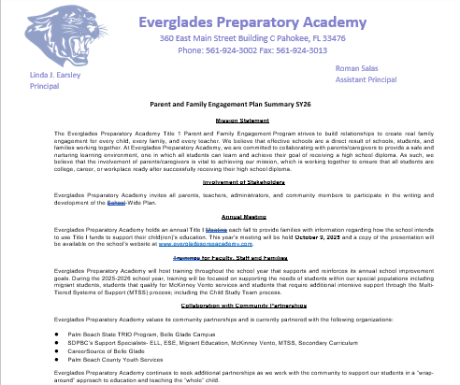
Parent & Family Engagement Plan
Notes:
Presenter dialogue –
The plan describes how the school partners with the community, volunteers, and businesses to increase student achievement. It also outlines specific academic trainings designed for parents and family members to learn strategies they can use at home and help their children master specific foundational skills.
Share – PFEP Summary will be posted on the school website. Optional – navigate to the school’s website.

Slide 13

Parent Trainings
In alignment with the Parent and Family Engagement Plan, we would like to invite you to attend our upcoming trainings:
Understanding Graduation Requirements for SY26 10/28 #1
Family Portal and Testing Training TBD #2
Notes:
Customize this slide to detail what your school is doing with Title I funds this year to increase student achievement for all students.
Be sure to include learning outcomes for parents and share what they can expect to learn from attending these interactive trainings.
Optional = Ask parents to enter these dates in their phone/calendar as save the date.

Slide 14

School-Parent Compact
Each Title I school must have a School-Parent Compact that is written by parents, family members and school personnel.
The School-Parent Compact sets out the responsibilities of the students, parents, family members, and school staff in striving to raise student achievement.
Notes:
Presenter dialogue –
An important part of the Parent and Family Engagement Plan is our School-Parent Compact. The Compact is also developed jointly with parents, family members and staff and outlines the responsibilities each have to raising student achievement.

Slide 15
School-Parent Compact
Review of FY26 School-Parent Compact
Suggestions for next year’s Compact
Questions
Notes:
Share your school’s final Compact.
Share with parents:
the importance of the School-Parent Compact
how it was developed and
how it is going to be used to impact student achievement
the Compact will be revisited during ELEMENTARY parent-teacher conferences (as required by law)

Slide 16

Parents’ Right to Know
Families have the right to ask:
  about the professional qualifications of their child’s teachers; and
  if non-teacher personnel are providing instruction to their child and, if so, their professional qualifications.
Notes:
Presenter dialogue –
Title I schools must inform parents and family members of their rights. Parents and family members have the right to request information regarding their child’s teachers and paraprofessionals’ qualifications and their child’s academic level and growth on State assessments.

Slide 17
Parents’ Right to Know
Families must be informed:
  if their child is taught for four or more weeks by a teacher who does not meet the certification requirements for the grade level or subject being taught; and
  how their child performed on state tests like FAST (PM1, PM2, PM3), EOCs, and SSA.
Notes:
Presenter dialogue –
Parents must be notified if their child has been taught for four or more weeks by a teacher who is licensed to teach in the State of Florida, but does not hold a certificate to teach the grade or subject listed above.
Parents must also be notified if their child has been taught for four or more weeks by a substitute teacher who is approved by the District to substitute teach, but does not hold a Florida Department of Education teaching certificate for the grade level or subject listed above.
School must share with parents their child’s assessments results (FSA, EOC and SSA).

Slide 18

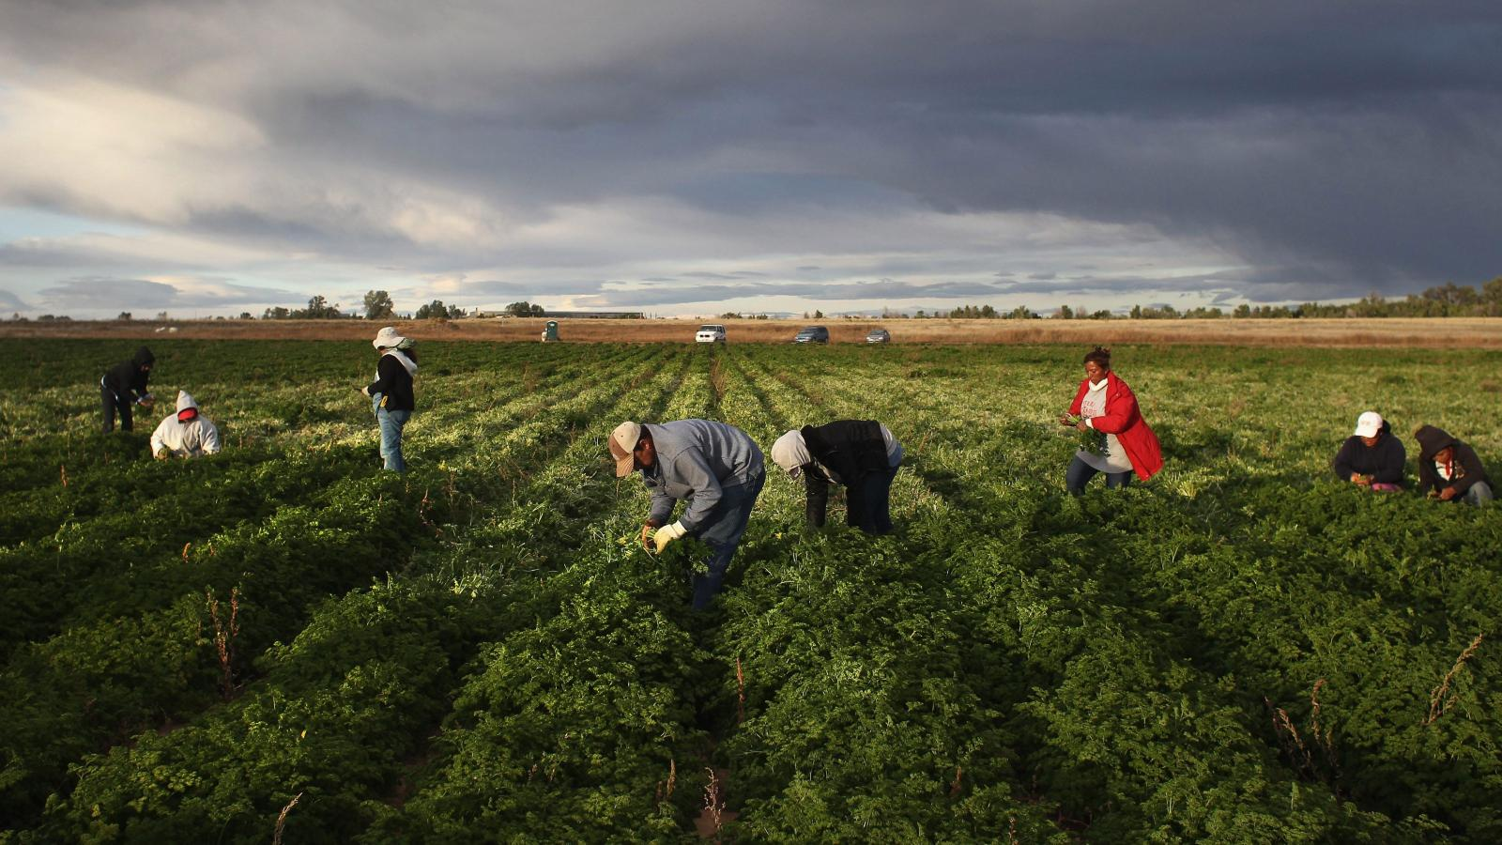
Migrant Education Program (MEP)
The GOAL of the MEP is to assist all migrant students in meeting challenging academic standards and achieving graduation from high school (or a GED program) with an education that prepares them for responsible citizenship, further learning, and productive employment.

Slide 19

Migrant Education Program
Ensure the needs of migrant students are met to help them overcome:
  interruption in schooling
  cultural and language barriers
  social isolation
  lack to health resources
  transition to college or work after high school
To improve educational opportunities of migrant students by helping them:
  Supplemental academic/social services to students and their families
  Transition to new school(s)
  meet the challenging state/district academic content
  graduate from high school
Notes:
Presenter dialogue –
The program provides supplemental academic and social support to migrant students and their families.

Slide 20
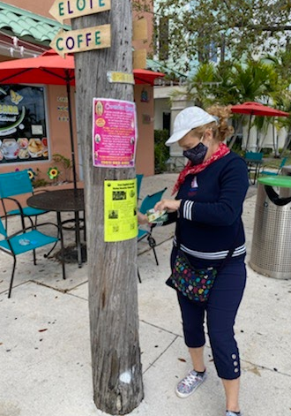

First step is to find all migrant students
Interviews are done in person by a training MEP Recruiter using Federal & State eligibility requirements
Program Contact Information:
Jorge Echegaray
Manager, Migrant Education Program
Multicultural Education Department
Jorge.Echegaray@palmbeachschools.org
(561) 202-0359

Slide 21

McKinney-Vento Program
Notes:
McKinney-Vento Program Team
(Funded by Title I and Title IX, Part A)
1 Program Planner, also serves as the Homeless Liaison for SDPBC
1 Academic Support Specialist
1 Case Manager - Identification & Transportation
10 Case Managers to assist schools & families

Slide 22
McKinney-Vento Program
The McKinney-Vento Program is designed to address the problems that homeless children and youth have faced in enrolling, attending, and succeeding in school.
McKinney-Vento Homeless Education Act
Federal law that protects the educational rights of children and youth experiencing homelessness.
Notes:
McKinney-Vento Program Team
(Funded by Title I and Title IX, Part A)
1 Program Planner, also serves as the Homeless Liaison for SDPBC
1 Academic Support Specialist
1 Case Manager - Identification & Transportation
10 Case Managers to assist schools & families

Slide 23
McKinney-Vento Program
Rights of eligible children and youth:
Right to immediate school enrollment when when records are not present
Right to remain in the school of origin, if in the student’s best interest
Right to receive transportation to and from the school of origin
Right to receive supplemental support for academic success
SDPBC Policy 5.74 - Students Experiencing Homelessness
Notes:
McKinney-Vento Program Team
(Funded by Title I and Title IX, Part A)
1 Program Planner, also serves as the Homeless Liaison for SDPBC
1 Academic Support Specialist
1 Case Manager - Identification & Transportation
10 Case Managers to assist schools & families

Slide 24
McKinney-Vento Homeless Assistance Act
Defines homeless children and youths as children and youths who lack a fixed, regular, and adequate nighttime residence; includes children and youths who:
Are sharing the housing of other persons due to loss of housing, economic hardship, or a similar reason;
Are living in motels, hotels, trailer parks, or camping grounds due to the lack of alternative adequate accommodations;
Are living in emergency or transitional shelters;
Are abandoned in hospitals;
Have a primary nighttime residence that is a public or private place not designed for or ordinarily used as a regular sleeping accommodation for human beings;
Are living in cars, parks, public spaces, abandoned buildings, substandard housing, bus or train stations, or similar settings; and
Are migratory children who qualify as homeless because the children are living in circumstances described above
SDPBC Policy 5.74 Students Experiencing Homelessness

Slide 25
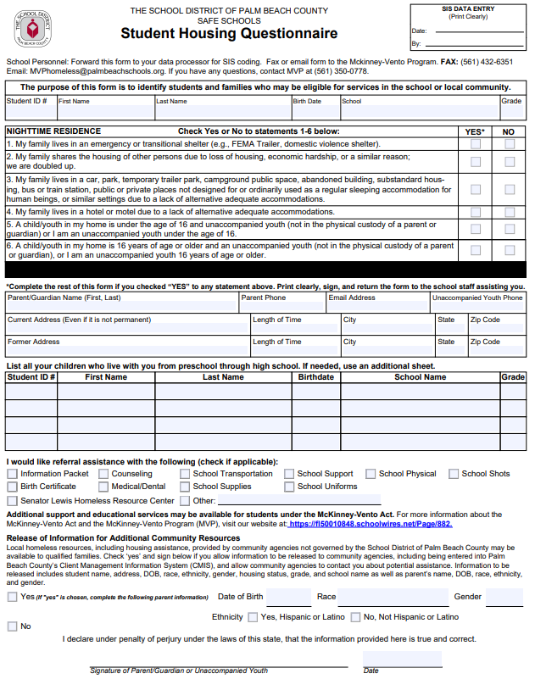
Identification of Eligible
Students
Student Housing Questionnaire (PBSD 2479)
Hard copies distributed by the school to students twice a year and as needed
Forms can also be completed online
Eligible students are enrolled in the McKinney-Vento Program (MVP) and provided services by the MVP Team
Partnered with community agencies to complete Student Housing Questionnaires with parents

Slide 26

FLDOE Required McKinney-Vento Goals
Each school district will:
Identify at least 5% of their FRL enrollment as homeless in a school year.
Achieve at least a 90% school attendance rate for students identified as homeless in a school year.
Promote at least 90% of students identified as homeless in a school year to the next grade at the end of each year.
Notes:
Students can’t miss no more than 10% of the school year to achieve a 90% attendance rate.

Slide 27
Services Provided by the SDPBC McKinney-Vento Program
Enrollment Assistance
Facilitating Student Access: The MVP Team provides enrollment support to ensure that students experiencing homelessness can quickly and efficiently register for school.
Transportation Support: The program offers transportation to the school of origin through district bus services, private transportation, mileage reimbursement, and Palm Tran passes for older students.
Support Services
Tutoring Services: District-certified teachers provide tutoring for students residing in homeless and domestic violence shelters.
School-Based Team Meetings: MVP Case Managers participate in school meetings to advocate for students and connect them to essential resources.
Attendance Monitoring: The MVP Team tracks student attendance monthly to identify and address potential issues.

Slide 28
Services Provided by the SDPBC McKinney-Vento Program
Year-Round Essentials
Supplies: The MVP Team distributes backpacks and school supplies throughout the year to ensure that students have the necessary tools for learning.
Uniforms: Eligible students are provided with uniforms, socks, and shoes to foster a sense of belonging and reduce the stigma associated with clothing disparities.
Hygiene Kits: Toiletry kits are provided to students’ basic hygiene needs, contributing to their overall well-being.
Community Outreach and Partnerships
Community Engagement: The MVP Team collaborates with the Welcome Center, churches, The Soup Kitchen, while also attending community events to raise awareness and improve access to services.
Workgroup Initiative: The McKinney-Vento Workgroup fosters collaboration among community organizations to build a network of resources that support families in Palm Beach County.

Slide 29
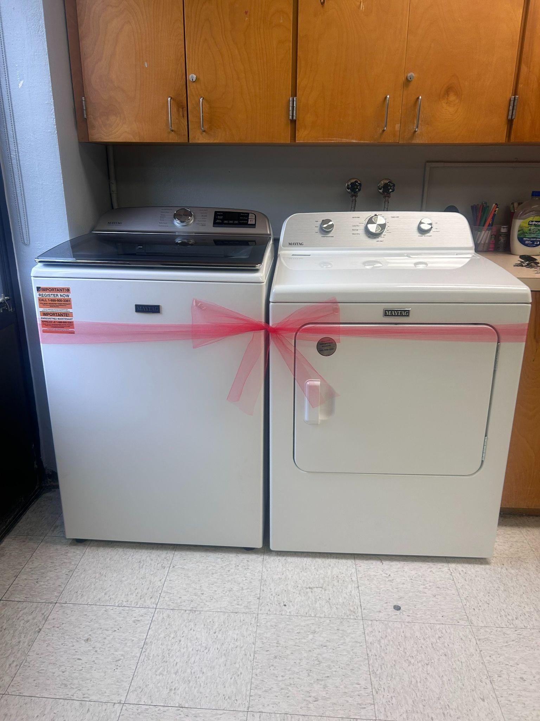
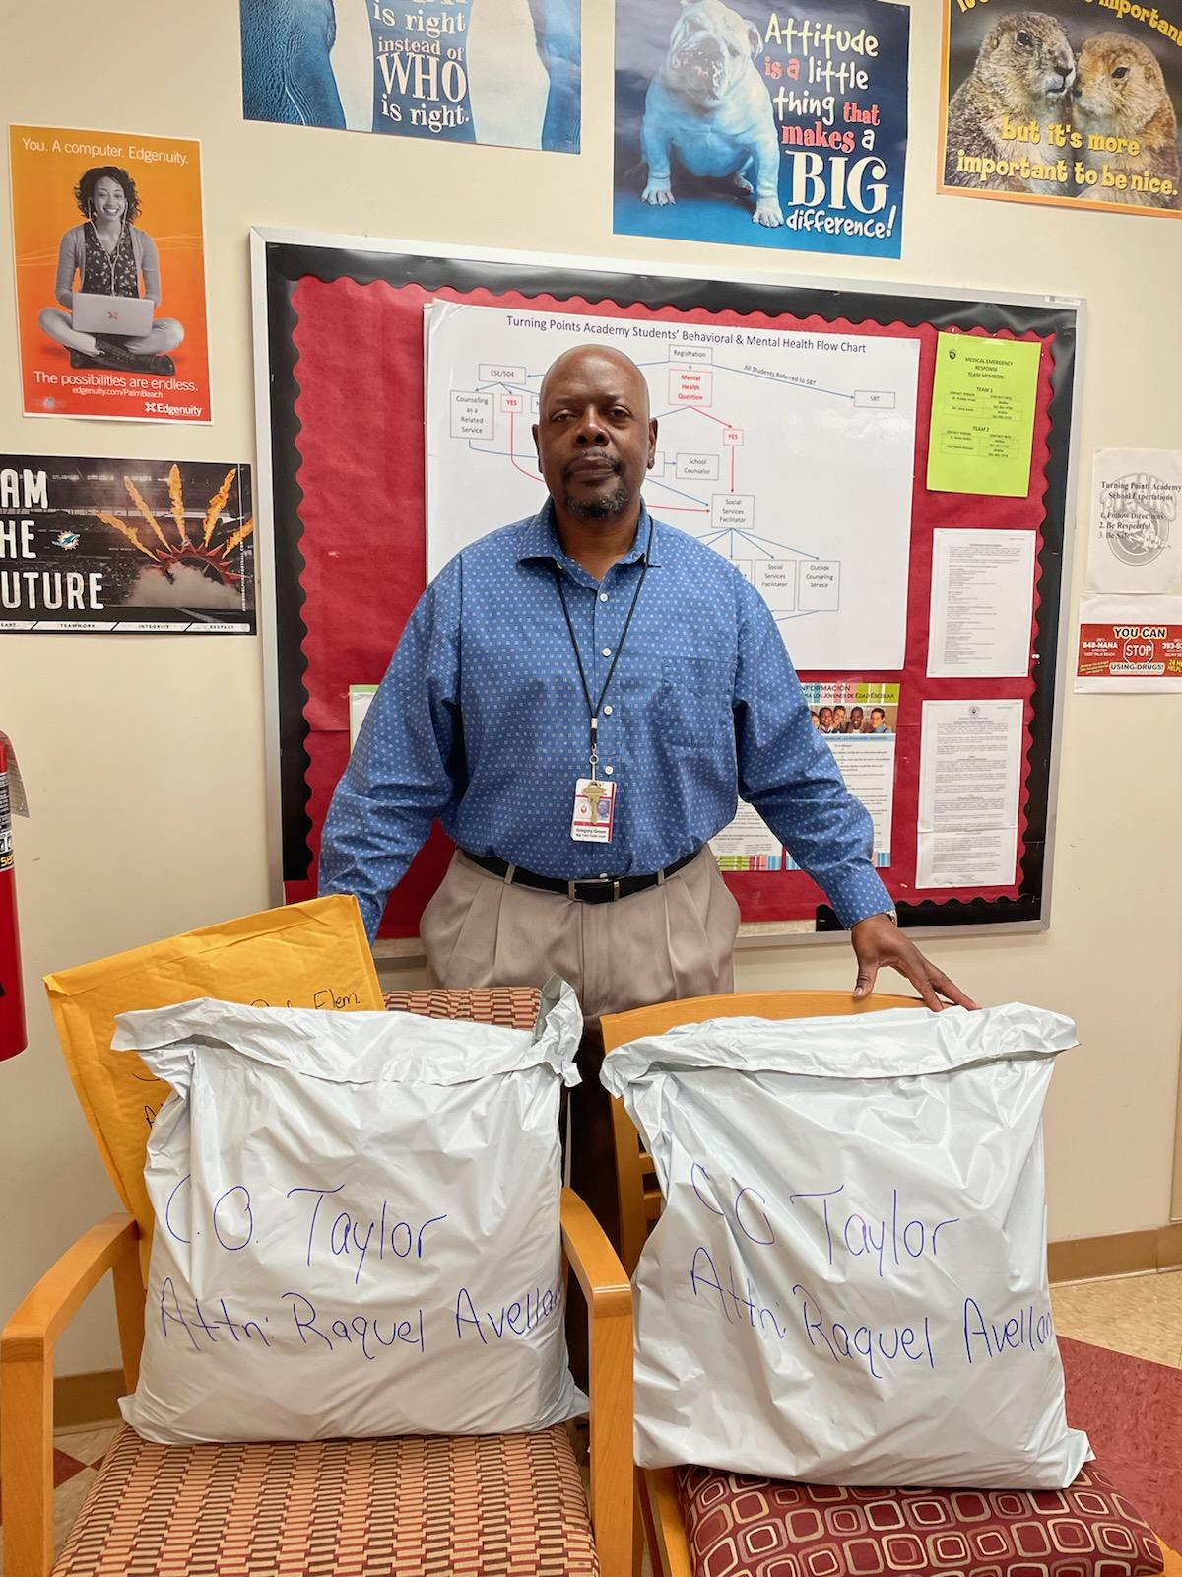
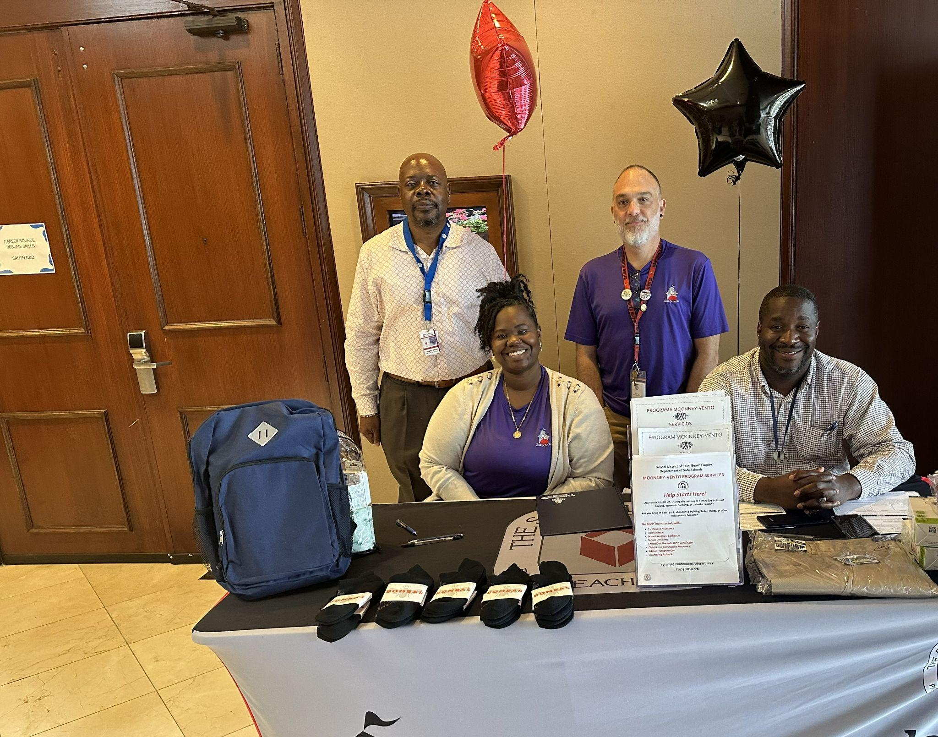
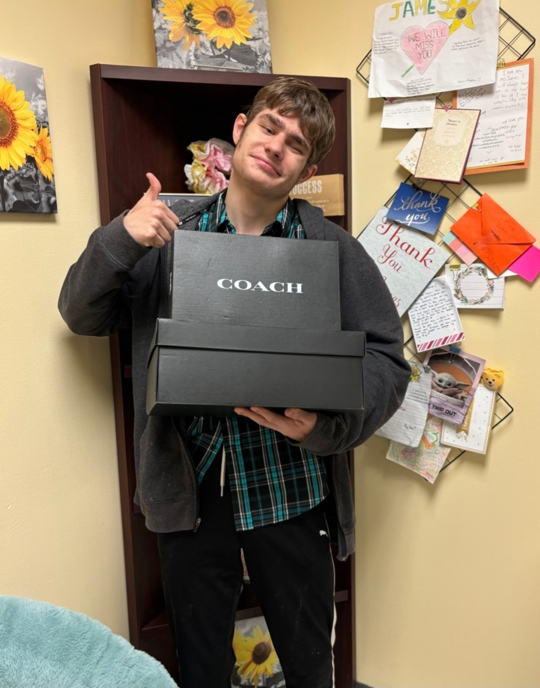
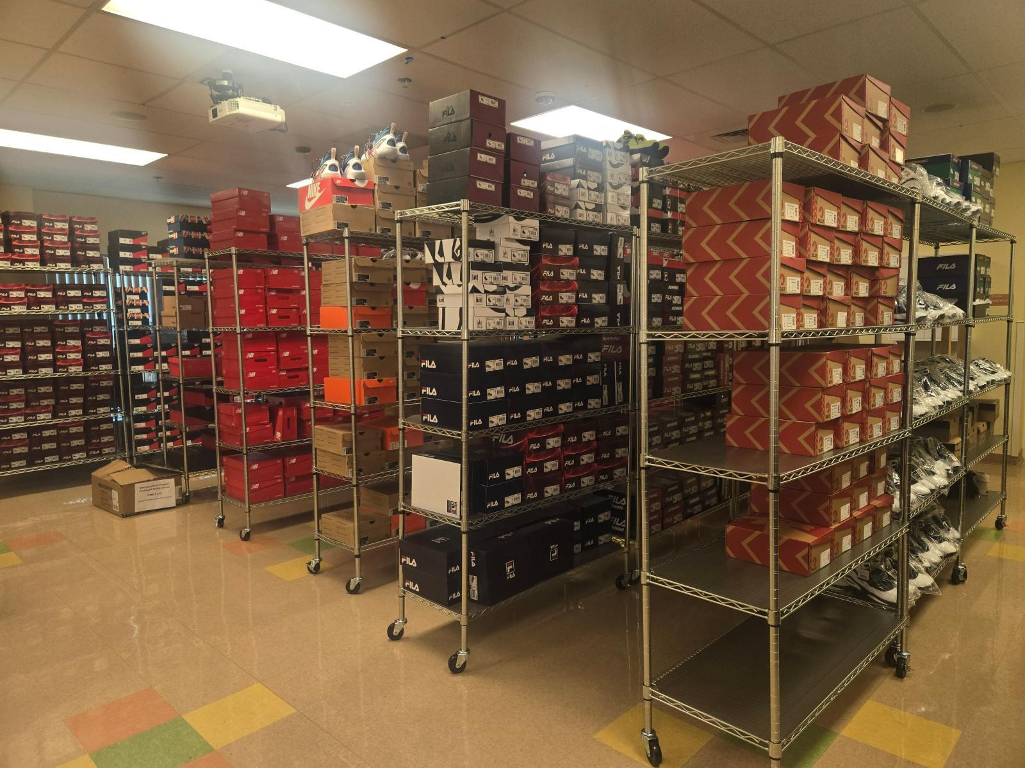
Services Provided by the SDPBC McKinney-Vento Program
Community Referrals and Assistance
Connecting Families with Resources: The MVP team provides referrals to community agencies offering services such as shelter, rental assistance, and housing to support families experiencing homelessness.
Laundry Services: Through a partnership with Degy Entertainment, the team is working to install washers and dryers at local schools providing students and families with essential laundry services.
Degy Entertainment
Palm Beach Lakes HS
Delivery of Essential Supplies
Outreach
Community Event
UHY Student
Shoe Donation
MVP Sneaker Closet

Slide 30
McKinney-Vento Program
Contact Information
Contact the McKinney-Vento Homeless Education Program (MVP) if you have questions or to complete a Student Housing Questionnaire
  Aleshia Coleman - Program Planner
    (561) 753-4057
    Aleshia.Coleman@palmbeachschools.org
  Department
    (561) 473-8104
    MVPhomeless@palmbeachschools.org
    MVP Website

Slide 31
Conclusion
Parents’ opportunity to ask questions and provide feedback
Complete evaluation
Thank you for your attendance, participation, and feedback.
We look forward to a successful school year!
Notes:
Presenter dialogue –
Ask if there are any questions.
Ask participants to complete evaluation using the link posted to school website under Annual Meeting.
Thank participants for attending.

